Slide 1

Noida Institute of Engineering and Technology, Greater Noida
Programming For Data Analytics
ACSAI0617
Unit: 3
Data Engineering Foundation
Mr. Raj u
Assistant Professor
Department CSE-Data Science
Course Details (B.Tech 6^{rth} Sem /3rd Year)

Slide 2
Table of Contents
Name of Subject with code, Course and Subject Teacher
Brief Introduction of Faculty member with Photograph
Evaluation Scheme
Subject Syllabus
Branch wise Applications
Course Objective (Point wise)
Course Outcomes (COs)
Program Outcomes only heading (POs)
COs and POs Mapping
Program Specific Outcomes (PSOs)

Slide 3
Conti….
COs and PSOs Mapping
Program Educational Objectives (PEOs)
Result Analysis (Department Result, Subject Result and Indivisual Faculty Result)
End Semester Question Paper Templates (Offline Pattern/Online Pattern)
Prerequisite/ Recap
Brief Introduction about the Subject with videos
Unit Content
Unit Objective
Topic Objective/Topic Outcome
Lecture related to topic
Daily Quiz
Weekly Assignment

Slide 4
Conti…
Topic Links
MCQ (End of Unit)
Glossary Questions
Old Question Papers (Sessional + University)
Expected Questions
Recap of Unit

Slide 5

Brief Introduction
My Self Mr. Raju working as Assistant Professor in Department of CSE-Data Science, NIET, Greater Noida since Nov., 2021. I have submitted my Ph.D in Jamia Millia Islamia, New Delhi. I have teaching experience of more than 9 years in Diploma and Degree Colleges. I have also worked on different Social Awareness programs in Previous College. I have published more than 6 papers in various reputed journals.
I have received my M.Tech Degree and Bachelor Degree from Department of Computer Engineering, Jamia Millia Islamia.
My Area of Expertise are Operating System, DBMS, IoT, IoT Security etc.,
languages know: C, C++, Python, R
Mr. Raju
Assistant Professor
Department of Data Science
Email: raju@niet.co.in
Contact No. 9716505971

Slide 6
Table of Contents
Name of Subject with code, Course and Subject Teacher
Brief Introduction of Faculty member with Photograph
Evaluation Scheme
Subject Syllabus
Branch wise Applications
Course Objective (Point wise)
Course Outcomes (COs)
Program Outcomes only heading (POs)
COs and POs Mapping
Program Specific Outcomes (PSOs)

Slide 7
Conti….
COs and PSOs Mapping
Program Educational Objectives (PEOs)
Result Analysis (Department Result, Subject Result and Indivisual Faculty Result)
End Semester Question Paper Templates (Offline Pattern/Online Pattern)
Prerequisite/ Recap
Brief Introduction about the Subject with videos
Unit Content
Unit Objective
Topic Objective/Topic Outcome
Lecture related to topic
Daily Quiz
Weekly Assignment

Slide 8
Conti…
Topic Links
MCQ (End of Unit)
Glossary Questions
Old Question Papers (Sessional + University)
Expected Questions
Recap of Unit

Slide 9

Evaluation Scheme

Slide 10
Syllabus
UNIT-I | BASIC DATA ANALYSIS USING PYTHON/R | 8 Hours
Pandas data structures Series and Data Frame, Data wrangling using pandas, Statistics with Pandas, Mathematical Computing Using NumPy, Data visualization with Python Descriptive and Inferential Statistics, Introduction to Model Building, Probability and Hypothesis Testing, Sensitivity Analysis, Regular expression: RE packages.
UNIT-II | R GRAPHICAL USER INTERFACES | 8 Hours
Built-in functions, Data Objects-Data Types & Data Structure, Structure of Data Items, Manipulating and Processing Data in R using Dplyr package & Stringr package, Building R Packages, Running and Manipulating Packages, data import and export, attribute and data types, descriptive statistics, exploratory data analysis, Flexdashboard and R-shiny.
UNIT-III | DATA ENGINEERING FOUNDATION | 8 Hours
Connecting to a database (sqlite) using Python, Sending DML and DDL queries and processing the result from a Python Program, Handling error, NOSQL query using MongoDB, MongoDB Compass.

Slide 11
Syllabus
UNIT-IV | INTRODUCTION TO TENSOR FLOW AND AI | 8 hours
Introduction, Using TensorFlow for AI Systems, Up and Running with TensorFlow, Understanding TensorFlow Basics, Convolutional Neural Networks, Working with Text and Sequences, and TensorBoard Visualization, Word Vectors, Advanced RNN, and Embedding Visualization. TensorFlow Abstractions and Simplifications, Queues, Threads, and Reading Data, Distributed TensorFlow, Exporting and Serving Models with TensorFlow.
UNIT-V | DEEP LEARNING WITH KERAS | 8 hours
Introducing Advanced Deep Learning with Keras, Deep Neural Networks, Autoencoders, Generative Adversarial Networks (GANs), Improved GANs, Disentangled Representation GANs, Cross-Domain GANs, Variational Autoencoders (VAEs), Deep Reinforcement Learning, Policy Gradient Methods.

Slide 12
Branch-wise Applications
Data analytics is used in most sectors of businesses. Here are some primary areas where data analytics does its magic:
Data analytics is used in the banking and e-commerce industries to detect fraudulent transactions.
The healthcare sector uses data analytics to improve patient health by detecting diseases before they happen. It is commonly used for cancer detection.
Data analytics finds its usage in inventory management to keep track of different items.
Logistics companies use data analytics to ensure faster delivery of products by optimizing vehicle routes.
Marketing professionals use analytics to reach out to the right customers and perform targeted marketing to increase ROI.
Data analytics can be used for city planning, to build smart cities.

Slide 13
Course Objectives
Demonstrate knowledge of statistical data analysis techniques utilized in business decision making. Apply principles of Data Science to the analysis of business problems. Use data mining software to solve real-world problems. Employ cutting edge tools and technologies to analyze Big Data.

Slide 14
Course Outcomes
After completion of this course students will be able to:
CO1 | Install, Code and Use Python & R Programming Language in R Studio IDE to perform basic tasks on Vectors, Matrices and Data frames.
CO2 | Implement the concept of the R packages.
CO3 | Understand the basic concept of the MongoDB.
CO4 | Understand and apply the concept of the RNN and tensorflow.
CO5 | Understand and evaluate the concept of the keras in deep learning.

Slide 15
Program Outcomes
1. Engineering knowledge:
2. Problem analysis:
3. Design/development of solutions:
4.Conduct investigations of complex problems
5. Modern tool usage
6. The engineer and society
7. Environment and sustainability
8. Ethics:
9. Individual and team work
10. Communication:
11. Project management and finance
12. Life-long learning

Slide 16
CO-PO Mapping
Mapping of Course Outcomes and Program Outcomes:
 | PO1 | PO2 | PO3 | PO4 | PO5 | PO6 | PO7 | PO8 | PO9 | PO10 | PO11 | PO12
CO.1 | 3 | 3 | 3 | 2 | 1 |  |  |  | 2 |  |  | 3
CO.2 | 3 | 3 | 3 | 2 | 1 |  |  |  | 2 |  |  | 3
CO.3 | 3 | 3 | 3 | 2 | 1 |  |  |  | 2 |  |  | 3
CO.4 | 3 | 3 | 3 | 2 | 1 |  |  |  | 2 |  |  | 3
CO.5 | 3 | 3 | 3 | 2 | 1 |  |  |  | 2 |  |  | 3

Slide 17
Program Specific Outcomes
On successful completion of graduation degree the Engineering graduates will be able to:
PSO1: Design innovative intelligent systems for the welfare of the people using machine learning and its applications.
PSO2: Demonstrate ethical, professional and team-oriented skills while providing innovative solutions in Artificial Intelligence and Machine Learning for life-long learning.

Slide 18
CO-PSO Mapping
Mapping of Course Outcomes and Program Specific Outcomes:
 | PSO1 | PSO2
CO.1 | 2 | 3
CO.2 | 2 | 3
CO.3 | 2 | 3
CO.4 | 2 | 3
CO.5 | 2 | 3

Slide 19
Program Educational Objectives
PEO1: Pursue higher education and professional career to excel in the field of Artificial Intelligence and Machine Learning.
PEO2: Lead by example in innovative research and entrepreneurial zeal for 21st century skills.
PEO3: Proactively provide innovative solutions for societal problems to promote life-long learning.

Slide 20
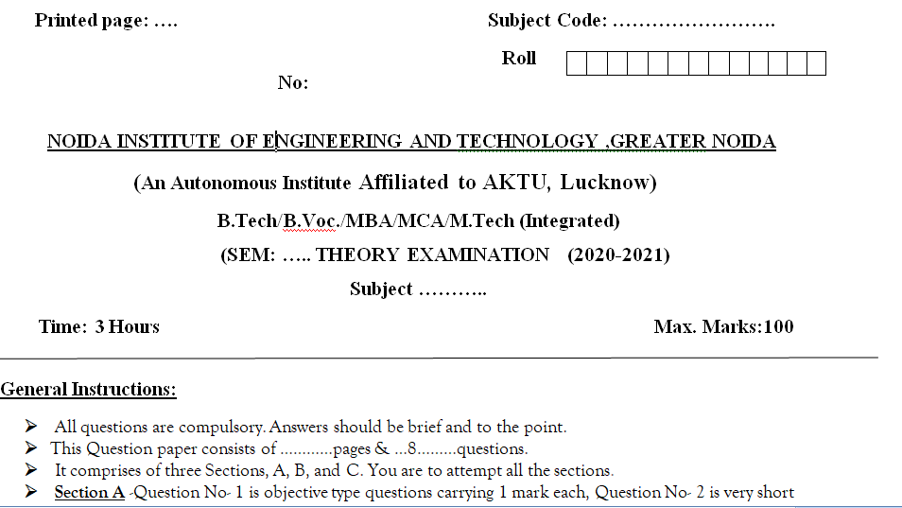
End Semester Question Paper Templates (Offline Pattern/Online Pattern)

Slide 21
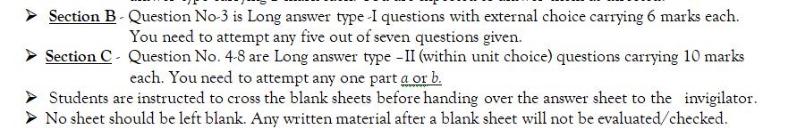
End Semester Question Paper Templates (Offline Pattern/Online Pattern)

Slide 22

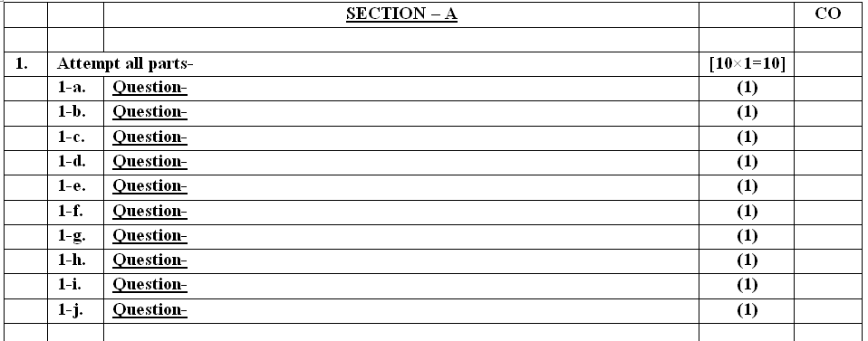
End Semester Question Paper Templates (Offline Pattern/Online Pattern)

Slide 23
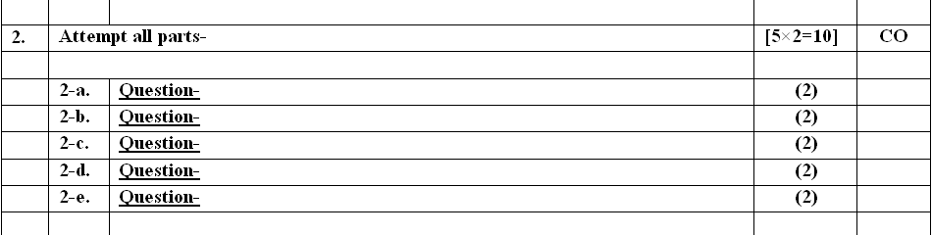
End Semester Question Paper Templates (Offline Pattern/Online Pattern)

Slide 24
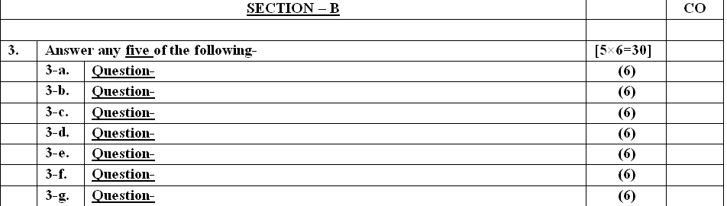
End Semester Question Paper Templates (Offline Pattern/Online Pattern)

Slide 25
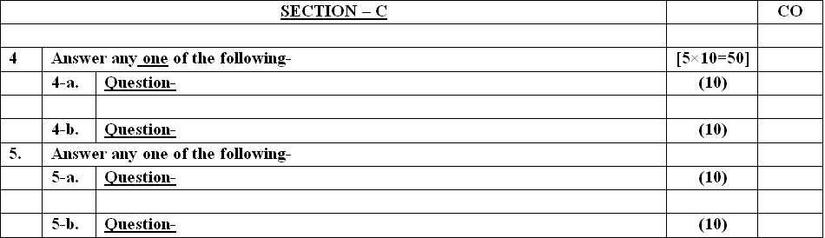
End Semester Question Paper Templates (Offline Pattern/Online Pattern)

Slide 26
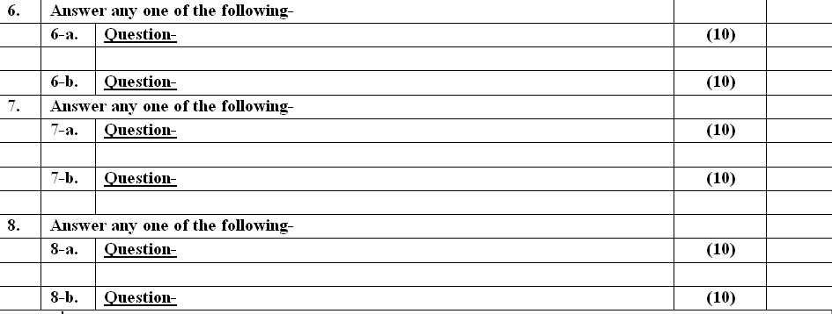
End Semester Question Paper Templates (Offline Pattern/Online Pattern)

Slide 27
About the Subject with videos
Data is getting generated at a massive rate, by the minute. Organizations, on the other hand, are trying to explore every opportunity to make sense of this data.
This is where Data analytics has become crucial in running a business successfully. It is commonly used in companies to drive profit and business growth
Link:
Unit 1 | https://www.ibm.com/cloud/blog/python-vs-r
Unit 2 | https://www.youtube.com/watch?v=C5R5SdYzQBI
Unit 3 | https://hevodata.com/learn/data-engineering-and-data-engineers/
Unit 4 | https://www.youtube.com/watch?v=IjEZmH7byZQ
Unit 5 | https://www.youtube.com/watch?v=pWp3PhYI-OU

Slide 28
UNIT CONTENT
Connecting to a database (sqlite) using Python
Sending DML and DDL queries and processing the result from a Python Program
Handling error
NOSQL query using MongoDB
MongoDB Compass

Slide 29
Unit Objectives
SQLite is a C library that provides a lightweight disk-based database that doesn't require a separate server process and allows accessing the database using a nonstandard variant of the SQL query language. Some applications can use SQLite for internal data storage.

Slide 30
Topic Objectives
SQLite does not require a separate server process or system to operate (serverless).
SQLite comes with zero-configuration, which means no setup or administration needed.
A complete SQLite database is stored in a single cross-platform disk file.
SQLite is very small and light weight, less than 400KiB fully configured or less than 250KiB with optional features omitted.
SQLite is self-contained, which means no external dependencies.

Slide 31
Introduction to SQLite in Python
SQLite is an in-process library that implements a self-contained, serverless, zero-configuration, transactional SQL database engine.
It is a database, which is zero-configured, which means like other databases you do not need to configure it in your system.
SQLite engine is not a standalone process like other databases,
It can be linked statically or dynamically as per our requirement with our application.
SQLite accesses its storage files directly.

Slide 32
Features of SQLite
SQLite does not require a separate server process or system to operate (serverless).
SQLite comes with zero-configuration, which means no setup or administration needed.
A complete SQLite database is stored in a single cross-platform disk file.
SQLite is very small and light weight, less than 400KB fully configured or less than 250KB with optional features omitted.
SQLite is self-contained, which means no external dependencies.
SQLite transactions are fully ACID-compliant, allowing safe access from multiple processes or threads.
SQLite supports most of the query language features found in SQL92 (SQL2) standard.
SQLite is written in ANSI-C and provides simple and easy-to-use API.
SQLite is available on UNIX (Linux, Mac OS-X, Android, iOS) and Windows (Win32, WinCE, WinRT).

Slide 33
Connecting to a database (sqlite) using Python
Connecting to the Database
Connecting to the SQLite Database can be established using the connect() method, passing the name of the database to be accessed as a parameter. If that database does not exist, then it’ll be created.
But what if you want to execute some queries after the connection is being made. For that, a cursor has to be created using the cursor() method on the connection instance, which will execute our SQL queries.
sqliteConnection = sqlite3.connect('sql.db')

Slide 34
Connecting to a database (sqlite)
The SQL query to be executed can be written in form of a string, and then executed by calling the execute() method on the cursor object. Then, the result can be fetched from the server by using the fetchall() method, which in this case, is the SQLite Version Number.
query = 'SQL query;‘
cursor.execute(query)
result = cursor.fetchall()
print('SQLite Version is {}'.format(result))

Slide 35
Installing SQLite
Installing SQLite

Slide 36
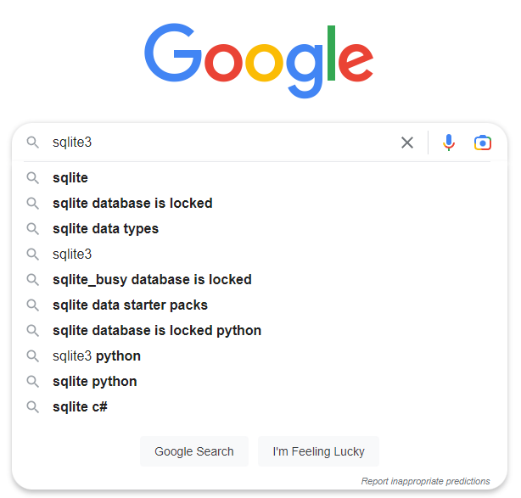

Install SQLite

Slide 37



Install SQLite

Slide 38

Install SQLite

Slide 39
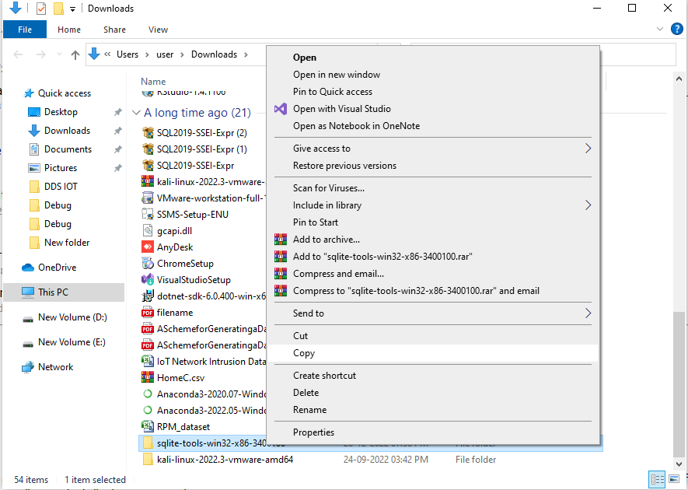
Install SQLite

Slide 40
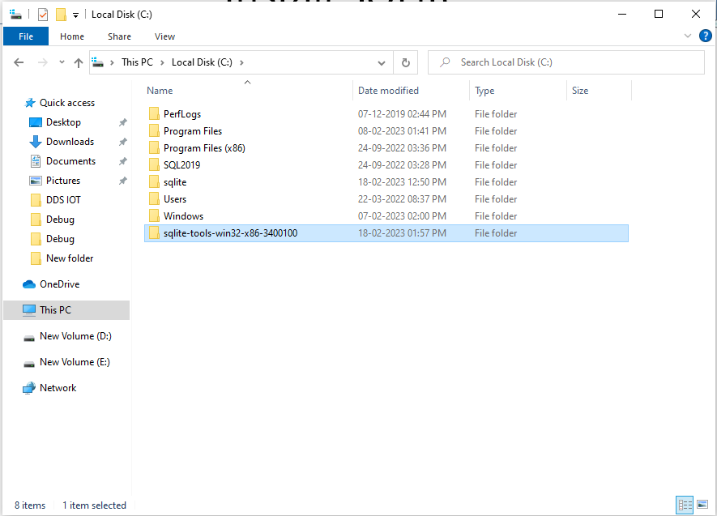
Install SQLite

Slide 41

Install SQLite

Slide 42
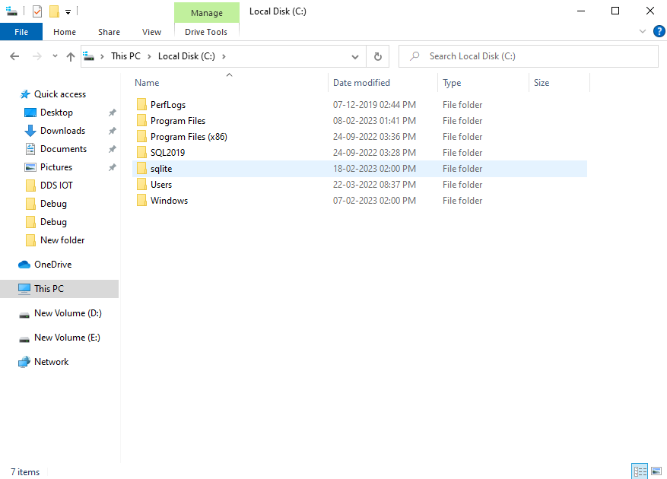
Install SQLite

Slide 43

Install SQLite

Slide 44

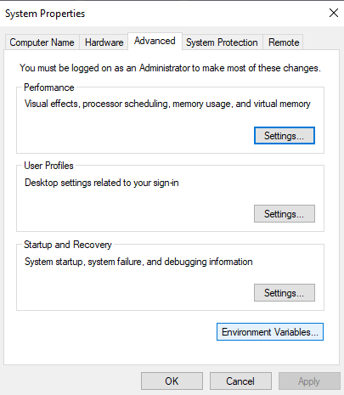
Install SQLite

Slide 45
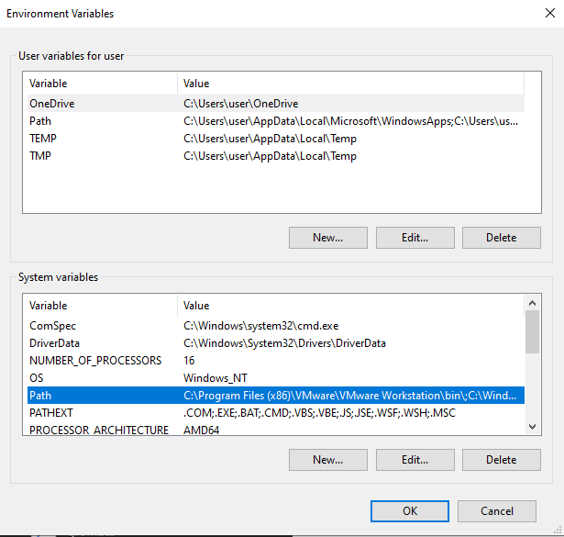
Install SQLite

Slide 46
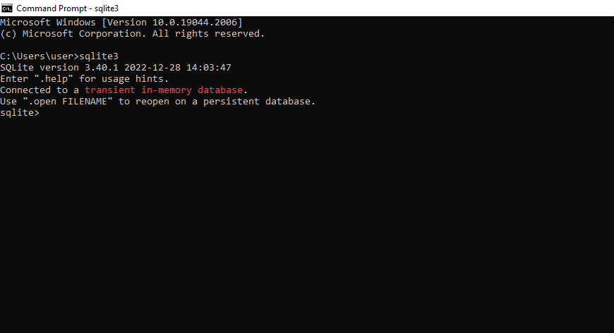
Install SQLite

Slide 47
Connecting to a database (sqlite) using Python
.quite command is used to exit from SQLite3
.databases command is used to see all databases
.sqlite3 <databasName>.db is used to create database
.tables is used to see table in a database
.schema <tablename> is used to see schema of a table.

Slide 48
Commands in SQLite
create table student(RollNo INT PRIMARY KEY, Name TEXT);
.tables
.schema student;
insert into student values(102,"Aman");
select *from student;
select *from student where RollNo = 101;
delete *from student where RollNo = 101;
insert into student values(101,"Paman");
Runtime error: UNIQUE constraint failed: student.RollNo (19)
select *from student where RollNo>105 and Name = "Gaman";
select *from student where RollNo>105 or Name = "Gaman";

Slide 49
Sending DML and DDL queries and processing the result from a Python Program
DDL (Data Definition Language):
DDL or Data Definition Language actually consists of the SQL commands that can be used to define the database schema. It simply deals with descriptions of the database schema and is used to create and modify the structure of database objects in the database. DDL is a set of SQL commands used to create, modify, and delete database structures but not data. These commands are normally not used by a general user, who should be accessing the database via an application.
List of DDL commands:
CREATE: This command is used to create the database or its objects (like table, index, function, views, store procedure, and triggers).
DROP: This command is used to delete objects from the database.

Slide 50
DDL (Data Definition Language)
DROP: This command is used to delete objects from the database.
ALTER: This is used to alter the structure of the database.
TRUNCATE: This is used to remove all records from a table, including all spaces allocated for the records are removed.
COMMENT: This is used to add comments to the data dictionary.
RENAME: This is used to rename an object existing in the database.
Python developers can use MariaDB Connector/Python to connect to MariaDB database products to perform basic DDL (Data Definition Language) operations.

Slide 51
DDL (Data Definition Language)
DDL Operations
MariaDB Connector/Python accesses the database through a cursor, which is obtained by calling the cursor() method on the connection. This cursor object provides you with an interface for performing basic operations in this section.
The cursor provides two methods for executing SQL statements:
Method | Description
execute() | Executes a single SQL statement.
executemany() | Executes the given SQL statement for each tuple in a list.

Slide 52
DDL (Data Definition Language)
Code Example: ALTER TABLE
The following example shows how to alter the data definition for the example table created in Setup for Examples:
# Module Import
import mariadb
import sys
# Alter Contacts
def alter_contacts(cur):
"""Alters data definition of contacts table to add a column""“

Slide 53
DDL (Data Definition Language)
try:
cur.execute("ALTER TABLE test.contacts ADD COLUMN IF NOT EXISTS (contact_since INT)")
except mariadb.Error as e:
print(f"Error altering contacts: {e}")
conn.close()
sys.exit(1)
# Instantiate Connection
try:
conn = mariadb.connect
( host="SKYSQL_SERVICE.mdb0000001.db.skysql.net",
port=5009,

Slide 54
DDL (Data Definition Language)
ssl_ca="/path/to/skysql_chain.pem",
user="DB00000001",
password="USER_PASSWORD")
except mariadb.Error as e:
print(f"Error connecting to the database: {e}")
sys.exit(1)
# Instantiate Cursor
cur = conn.cursor()
alter_contacts(cur)
# Close Connection
conn.close()

Slide 55
DDL (Data Definition Language)
The function to alter table must be defined before being called with regards to its ordering in the script.
The execute() method is called on the cursor, which executes a ALTER TABLE statement to alter the table.
The query string is the only value specified to the execute() method.
When you are done with a connection, close it to free resources. Close the connection using the close() method.

Slide 56
DDL (Data Definition Language)
Confirm the table was properly altered by using MariaDB Client to execute a DESC statement on the same table:
DESC contacts;
Field | Type | Null | Key | Default | Extra
id | int(11) | NO | PRI | NULL | auto_increment
first_name | varchar(25) | YES |  | NULL
last_name | varchar(25) | YES |  | NULL
email | varchar(100) | YES |  | NULL
contact_since | int(11) | YES |  | NULL

Slide 57
DML(Data Manipulation Language)
DML(Data Manipulation Language):
The SQL commands that deals with the manipulation of data present in the database belong to DML or Data Manipulation Language and this includes most of the SQL statements. It is the component of the SQL statement that controls access to data and to the database. Basically, DCL statements are grouped with DML statements.
List of DML commands:
INSERT : It is used to insert data into a table.
UPDATE: It is used to update existing data within a table.
DELETE : It is used to delete records from a database table.
LOCK: Table control concurrency.

Slide 58
DML(Data Manipulation Language)
DML Operations
MariaDB Connector/Python accesses the database through a cursor, which is obtained by calling the cursor() method on the connection. This object provides an interface for performing basic operations in this section.
The cursor provides two methods for executing SQL statements:
Method | Description
execute() | Executes a single SQL statement.
executemany() | Executes the given SQL statement for each tuple in a list.

Slide 59
DML(Data Manipulation Language)
Code Example: INSERT, UPDATE, DELETE
INSERT, UPDATE, and DELETE are DML (Data Manipulation Language) operations that modify the data in a table.
The following example shows how to insert data into the example table created in Setting up the Environment:
To update or delete data, replace the INSERT statement in the code example with an UPDATE or DELETE statement:

Slide 60
DML(Data Manipulation Language)
# Module Import
import mariadb
import sys
# Adds single contact
def add_contact(cur, first_name, last_name, email):
"""Adds the given contact to the contacts table"""
cur.execute("INSERT INTO test.contacts(first_name, last_name, email) VALUES (?, ?, ?)",
(first_name, last_name, email))

Slide 61
DML(Data Manipulation Language)
# Adds Multiple contacts
def add_multiple_contacts(cur, data):
"""Adds multiple contacts to database from given data"""
cur.executemany("INSERT INTO test.contacts(first_name, last_name, email) VALUES (?, ?, ?)", data)
# Instantiate Connection
try:
conn = mariadb.connect(
host="SKYSQL_SERVICE.mdb0000001.db.skysql.net",
port=5009,

Slide 62
DML(Data Manipulation Language)
ssl_ca="/path/to/skysql_chain.pem",
user="DB00000001",
password="USER_PASSWORD",
autocommit=True)
except mariadb.Error as e:
print(f"Error connecting to the database: {e}")
sys.exit(1)
# Instantiate Cursor
cur = conn.cursor()

Slide 63
DML(Data Manipulation Language)
# Initialize Data to add a single contact
new_contact_fname = "J. R. R."
new_contact_lname = "Tolkien"
new_contact_email = "jrr.tolkien@example.edu"
# Call function to add a single contact
add_contact(cur,
new_contact_fname,
new_contact_lname,
new_contact_email)

Slide 64
DML(Data Manipulation Language)
# Initialize Data to add multiple contacts
new_contacts = [
("Howard", "Lovecraft", "hp.lovecraft@example.net"),
("Flannery", "O'Connor", "flan.oconnor@example.com"),
("Walker", "Percy", "w.percy@example.edu")
]
# Call function to add multiple contacts
add_multiple_contacts(cur, new_contacts)
# Close Connection
conn.close()

Slide 65
DML(Data Manipulation Language)
The functions to add data must be defined before being called with regards to their ordering in the script.
The autocommit attribute must be set to True in the mariadb.connect() function call to enable auto-commit mode because by default Connector/Python does not enable auto-commit.
The execute() method is called on the cursor, which executes an INSERT statement to add a single contact to the table.
The query string is the only value specified to the execute() method.
The executemany() method is called on the cursor, which executes an INSERT statement to add multiple contacts to the table.

Slide 66
DML(Data Manipulation Language)
The query string is the only value specified to the executemany() method.
When you are done with a connection, close it to free resources. Close the connection using the close() method.
Confirm the data was properly inserted by using MariaDB Client to execute a SELECT statement:
SELECT * from contacts;

Slide 67
DML(Data Manipulation Language)
id | first_name | last_name | email
1 | J. R. R. | Tolkien | jrr.tolkien@example.edu
2 | Howard | Lovecraft | hp.lovecraft@example.net
3 | Flannery | O'Connor | flan.oconnor@example.com
4 | Walker | Percy | w.percy@example.edu

Slide 68
Error Handling
Error Handling
Just like the mysqli extension, SQLite error handling differs depending on whether you use the procedural or object-oriented interface.With the procedural interface, you must check the return value of each SQLite call and then consult the message in a special SQLite error variable.
Alternatively, the SQLite object tosses an SQLiteException whenever it encounters dragons.
Procedural error handling
Here is a good way to structure your procedural code to check for SQLite errors:

Slide 69
Error Handling
$db = sqlite_open($database, 0666, $sqlite_error) or die ($sqlite_error);
if ($r = sqlite_query($db, $sql)) {
// row iteration code here
} else {
die (sqlite_error_string(sqlite_last_error($db)));

Slide 70
Error Handling
There are three different ways to access SQLite errors. When you initially try to connect to an SQLite database, the third parameter to sqlite_open( ) (in this case $sqlite_error) is a variable passed by reference. If SQLite cannot open the database, it will return false and store the error message in $sqlite_error.
The second parameter to sqlite_open( ) is the mode, which is an octal number that describes the file permissions SQLite uses when creating a new database. Currently, the SQLite extension always uses a mode of 0666, regardless of whatâs passed in during sqlite_open( ). In other words, this value is ignored completely; however, it may be respected in future versions of the extension. This mode means the database is readable and writable by all users, including the web server.

Slide 71
Error Handling
Once your connection is established, SQLite still returns false upon errors, but it no longer uses $sqlite_error. Instead, it has a pair of error-reporting functions: sqlite_last_error( ) and sqlite_error_string( ).
The first function, sqlite_last_error( ), returns the SQLite error code for the most recent error. Since the error code is a number, itâs not very helpful for humans. To convert the number to an actual error message, pass it to sqlite_error_string( ).
In the previous example, any error triggers a die( ). More user-friendly applications require gentler error handling. Using error_log( ) in combination with a polite, generic message to users may be the best solution.
You cannot âsave upâ error checking while you complete a series of queries. SQLite resets the value returned by sqlite_last_error( ) after every query, so old error messages will be removed before you view them. SQLite even resets the message after an error-free query, so a query with an error followed by valid query leaves you with an error message of not an error.

Slide 72
Querying in NoSQL
NoSQL is termed non-SQL. We won’t use SQL to write queries in No SQL. It is not relational but it gives us an organized way of storing data. The data is stored in the form of documents rather than tabular form. The best example for NoSql is Mongo DB. In SQL we will use the term key-value pairs but in Mongo DB we will use field-value pairs. Documents are stored and the group of documents is called “Collection”. The document will be in JSON format. The data is called a “Document” and the collection of documents is called a “Collection”.

Slide 73
Querying in NoSQL
Steps to query in Mongo DB:
Install the MongoDB installer.
Specify a custom directory for mongo.
After installation runs the Mongo DB daemon.
Connect to Mongo shell.
You can start to code.

Slide 74
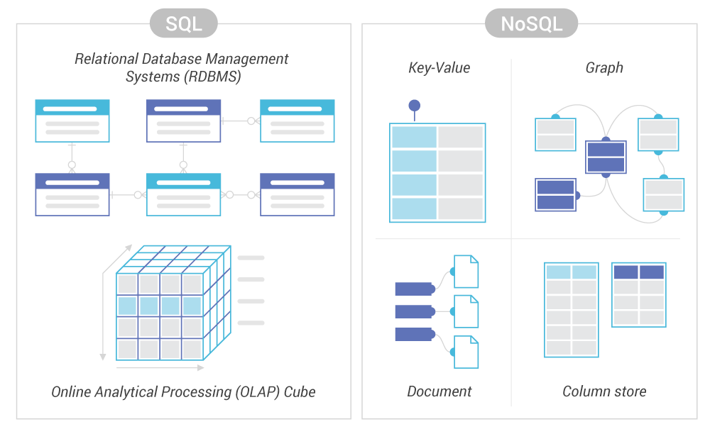
Comparison between SQl and NoSQL

Slide 75
Introduction
Introduction of MongoDB
MongoDB is an open-source document-oriented database
It is designed to store a large scale of data.
MongoDB also allows to work with data very efficiently.
It is categorized under the NoSQL (Not only SQL) database.
It also provides official driver support for all the popular languages like C, C++, C#, and .Net, Go, Java, Node.js, Perl, PHP, Python, Motor, Ruby, Scala, Swift, Mongoid.
MongoDB is going to use in Facebook, Nokia, eBay, Adobe, Google, etc. to store their large amount of data.

Slide 76
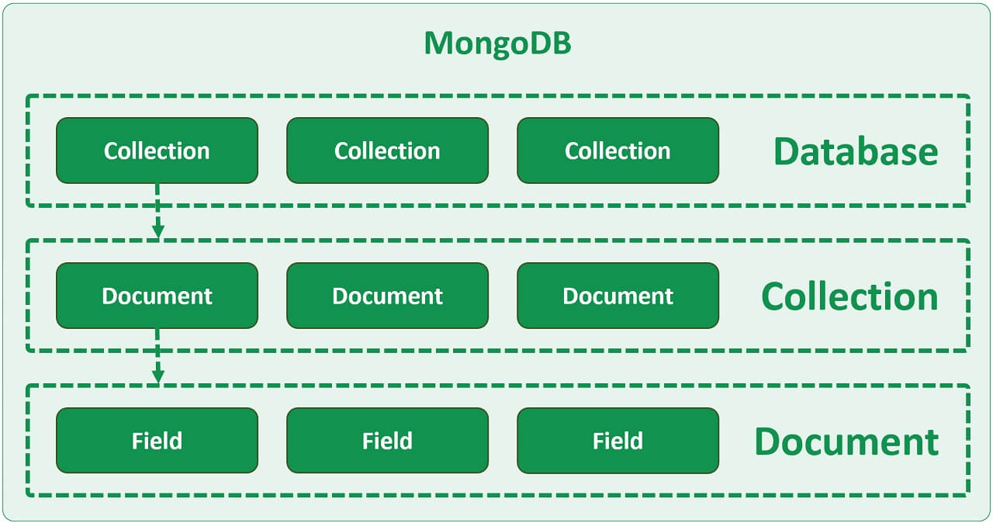
Working
Working of MongoDB
MongoDB environment gives you a server that you can start and then create multiple databases on it using MongoDB.
In MonoDB the data is stored in the collections and documents because of its NoSQL database.
In MongoDB database, collection, and documents are related to each other

Slide 77
Working
Working of MongoDB
The MongoDB database contains collections and you can create multiple databases and multiple collections.
Inside of the collection we have documents and Inside documents we have data fileds.
In MongoDB, documents are schema-less, it means it is not compulsory that all documents are same.
In MongoDB, documents are created using the fields and Fields are key-value pairs in the documents,
The value of the fields can be of any BSON data types like double, string, boolean, etc.
The data stored in the MongoDB is in the format of BSON (Binary representation of JSON) documents.
Or in other words, in the backend, the MongoDB server converts the JSON data into a binary form that is known as BSON and this BSON is stored and queried more efficiently.
In MongoDB, data can be stored in nested form which allow us to create complex relation between data.

Slide 78
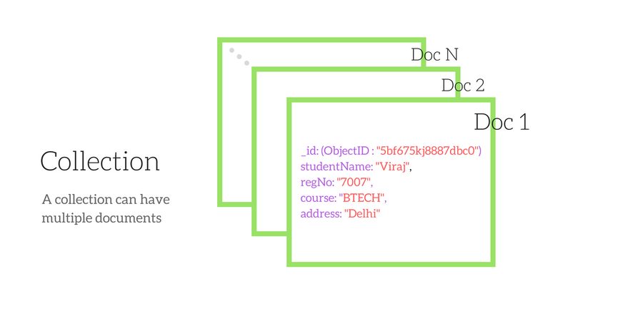
Collections

Slide 79
Collections
Collections
Collection is a group of documents.
Collection is equivalent to RDBMS table.
A collection consist inside a single database.
Collections do not enforce a schema.
A Collection can have different fields within a Documents.

Slide 80
Naming Restrictions for Collection:
Collections
Collection name must starts with an underscore or a character.
Collection name does not contain $, empty string, null character and does not begin with system. prefix.
The maximum length of the collection name is 120 bytes(including the database name, dot separator, and the collection name).

Slide 81
n
Database
Database is a container for collections.
Each database gets its ow set of files.
A single MongoDB server can has multiple databases.

Slide 82
:
Naming restriction of fields
The field names are of strings.
The _id field name is reserved to use as a primary key. And the value of this field must be unique, immutable, and can be of any type other than an array.
The field name cannot contain null characters.
The top-level field names should not start with a dollar sign ($).
Document Size:
The maximum size of the BSON document is 16MB.
It ensures that the single document does not use too much amount of RAM or bandwidth(during transmission).
If a document contains more data than the specified size, then MongoDB provides a GridFS API to store such type of documents.

Slide 83
Applications
Mobile and Social Infrastructure
Data Hub
Previous Pag
Big Data
User Data Management
Content Management and Delivery

Slide 84
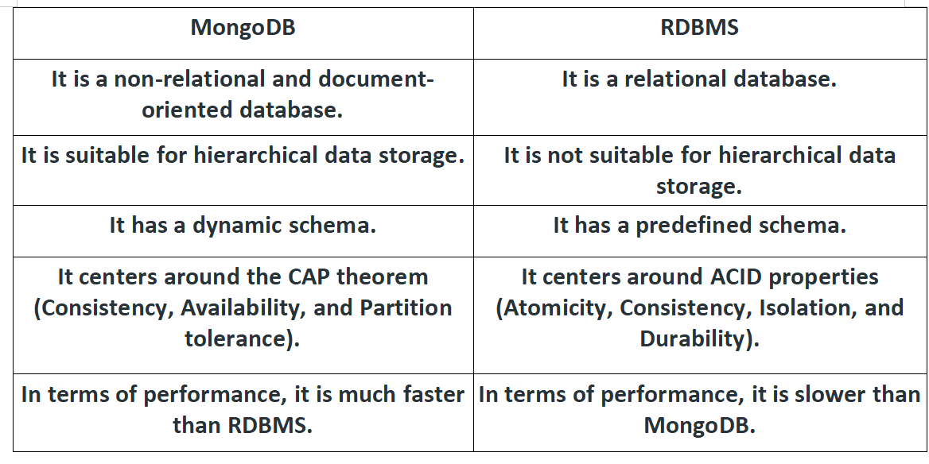
MongoDB vs. RDBMS

Slide 85
MongoDB vs. RDBMS

Slide 86
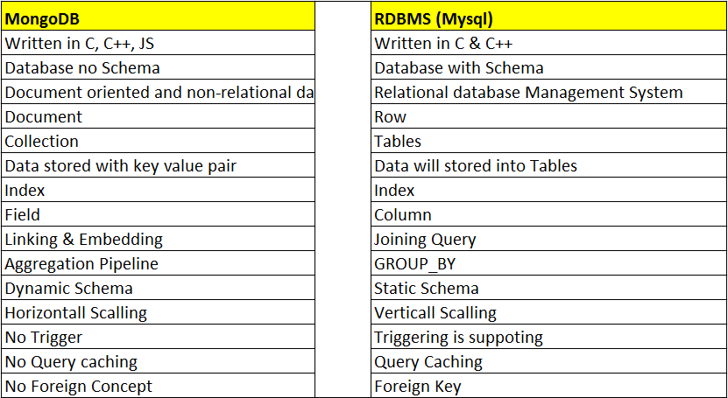
MongoDB vs. RDBMS
MongoDB vs. RDBMS

Slide 87
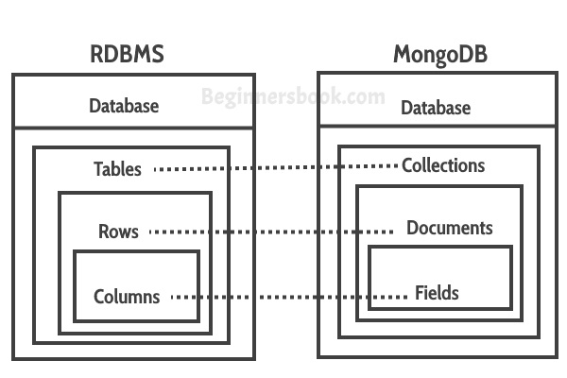
MongoDB vs. RDBMS
MongoDB vs. RDBMS

Slide 88
Features of MongoDB
Schema-less Database:
A Schema-less database means one collection can hold different types of documents in it.
Document Oriented:
All data stored in documents instead of tables/relation where data stored in key-value pair instead of rows and columns
Each document contains Unique object id
Indexing:
In MongoDB database, every field in the documents is indexed with primary and secondary indices this makes easier and takes less time to get or search data from the pool of the data.

Slide 89
Features of MongoDB
Features of MongoDB
Scalability:
MongoDB provides horizontal scalability with the help of sharding.
Sharding means to distribute data on multiple servers,
here a large amount of data is partitioned into data chunks using the shard key, and these data chunks are evenly distributed across shards that reside across many physical servers.
It will also add new machines to a running database.
Replication:
MongoDB provides high availability and redundancy with the help of replication,
it creates multiple copies of the data and sends these copies to a different server so that if one server fails, then the data is retrieved from another server.
Aggregation:
It allows to perform operations on the grouped data and get a single result or computed result. It is similar to the SQL GROUPBY clause.
It provides three different aggregations i.e, aggregation pipeline, map-reduce function, and single-purpose aggregation methods
High Performance:
The performance of MongoDB is very high and data persistence as compared to another database due to its features like scalability, indexing, replication, etc.

Slide 90
Advanta
Advantages of MongoDB
It is a schema-less NoSQL database. You need not to design the schema of the database when you are working with MongoDB.
It does not support join operation.
It provides great flexibility to the fields in the documents.
It contains heterogeneous data.
It provides high performance, availability, scalability.
It supports Geospatial efficiently.
It is a document oriented database and the data is stored in BSON documents.
It also supports multiple document ACID transition(string from MongoDB 4.0).
It does not require any SQL injection.
It is easily integrated with Big Data Hadoop

Slide 91
Disadvantages of MongoDB
It uses high memory for data storage.
You are not allowed to store more than 16MB data in the documents.
The nesting of data in BSON is also limited you are not allowed to nest data more than 100 levels.

Slide 92
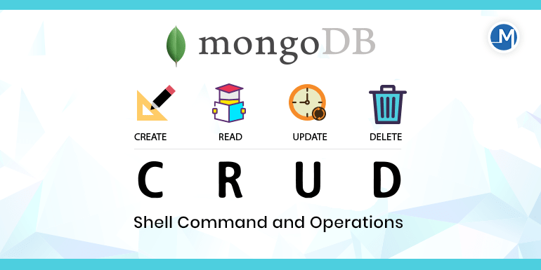
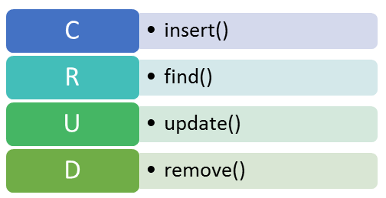

Slide 93
MongoDB Shell Commands
1. Get List of database
Command: show dbs
2. Get current database name
Command: db
3. Switch to another database
Command: use database_name
Example: use testdb
4. Create new table
command: db.createCollection('table_name')
Example: db.createCollection(‘tbl_user’)

Slide 94
MongoDB Shell Commands
MongoDB Shell Commands
5. Get List of table
Command: show collections
6. Insert record in table (
command : db.table_name.insert( {key:"value",....} )
Example: db.tbl_user.insert( { name: “Sam”, status: “Active”,email:”sam01@gmail.com” } )
7. Insert multiple records in table (
command : db.table_name.insertMany( {key:"value",....},{key:"value",....},...)
Example: db.tbl_user.insertMany( [{ name: “Sam”, status: “Active”,email:”sam01@gmail.com” },{ name: “Anddy”, status: “Active”,email:”anddy01@gmail.com” }] )
8. List record of table
Command: db.table_name.find() Or db.table_name.find().pretty()
Example: db.tbl_user.find() Or db.tbl_user.find().pretty()

Slide 95
MongoDB Shell Commands
9. Update record
Command: db.table_name.update({key:"value"}, {$set: {key:"new_value"}})
Example: db.tbl_user.update({name:”Sam”}, {$set: {email:”sam.mobio@gmail.com”}})
10. Delete Record
Command: db.table_name.deleteOne({key:"value"})
Example: db.tbl_user.deleteOne({name:”Sam”})
11. Delete multiple record for given condition
Command: db.table_name.deleteMany({key:"value"})
Example: Command: db.tbl_user.deleteMany({email:”sam.mobio@gmail.com”})
12. Search Record in table
Command: db.table_name.find({key:"value"}).pretty()
Example: db.tbl_user.find({name:”Sam”}).pretty()

Slide 96
Insert Documents
insert documents
db.collection.insertOne() inserts a single document into a collection.
db.inventory.insertOne(
{ item: "canvas", qty: 100, tags: ["cotton"], size: { h: 28, w: 35.5, uom: "cm" } }
)
To retrieve the document that you just inserted, query the collection:
db.inventory.find( { item: "canvas" } )
db.collection.insertMany() can insert multiple documents into a collection. Pass an array of documents to the method.
db.inventory.insertMany([
{ item: "journal", qty: 25, tags: ["blank", "red"], size: { h: 14, w: 21, uom: "cm" } },
{ item: "mat", qty: 85, tags: ["gray"], size: { h: 27.9, w: 35.5, uom: "cm" } },
{ item: "mousepad", qty: 25, tags: ["gel", "blue"], size: { h: 19, w: 22.85, uom: "cm" } }
])
To retrieve the inserted documents, query the collection:
db.inventory.find( {} )

Slide 97
Update Documents
Update Document
To update a document, MongoDB provides update operators, such as $set, to modify field values.
db.inventory.updateOne(
{ item: "paper" },
{
$set: { "size.uom": "cm", status: "P" },
$currentDate: { lastModified: true }
}
)
The update operation:
uses the $set operator to update the value of the size.uom field to "cm" and the value of the status field to "P",
uses the $currentDate operator to update the value of the lastModified field to the current date.
If lastModified field does not exist, $currentDate will create the field. See $currentDate for details.

Slide 98
Delete Documents
Delete Documents
db.collection.deleteMany(): To delete all documents from a collection, pass an empty filter document {} to the db.collection.deleteMany() method
db.inventory.deleteMany({})
removes all documents from the inventory collection where the status field equals "A":
db.inventory.deleteMany({ status : "A" })
db.collection.deleteOne(): To delete at most a single document that matches a specified filter (even though multiple documents may match the condition.
db.inventory.deleteOne( { status: "D" } )

Slide 99
Comparison Query Operators
Comparison Query Operators
$eq
Matches values that are equal to a specified value.
db.Faculty.find({Age:{$eq :32}})
$gt
Matches values that are greater than a specified value.
db.Faculty.find({Age:{$gt :36}})
$gte
Matches values that are greater than or equal to a specified value.
db.Faculty.find({Age:{$gte :32}})
$in
Matches any of the values specified in an array.
db.Faculty.find({Age:{$in :[32,30]}})

Slide 100
Comparison Query Operators
Comparison Query Operators
$lt
Matches values that are less than a specified value.
db.Faculty.find({Age:{$lt :36}})
$lte
Matches values that are less than or equal to a specified value.
db.Faculty.find({Age:{$lte :32}})
$ne
Matches all values that are not equal to a specified value.
db.Faculty.find({Age:{$ne :32}})
$nin
Matches none of the values specified in an array.
db.Faculty.find({Age:{$nin :[32,30]}})

Slide 101
Comparison Query Operators
db.Faculty.find({Age:{$nin :[32,30]}}).sort({Age : -1})
db.Faculty.find({Age:{$nin :[32,30]}}).sort({Age : 1})

Slide 102
Logical Query Operators
$and
Joins query clauses with a logical AND returns all documents that match the conditions of both clauses.
Syntax: { $and: [ { <expression1> }, { <expression2> } , ... , { <expressionN> } ] }
{$and:[{"FacultyName":"Dr. GMJ"},{"Age":{$lt:38}}]}
db.Faculty.find({ $and :[{FacultyID:104},{Age:{$lt:34}}]})
$not
Inverts the effect of a query expression and returns documents that do not match the query expression.
Syntax: { field: { $not: { <operator-expression> } } }
db.Faculty.find({Age:{$not:{$eq : 32}}})
{Age : { $not :{ $eq :{Age:30}}}}

Slide 103
Logical Query Operators
$nor
Joins query clauses with a logical NOR returns all documents that fail to match both clauses.
{ $nor: [ { <expression1> }, { <expression2> }, ... { <expressionN> } ] }
{$nor:[{CITY:"DELHI"},{Age:{$lt:{Age:35}}}]}
db.Faculty.find({$nor:[{Age:{$eq : {Age:32}}},{CITY:"DELHI"}]})
$or
Joins query clauses with a logical OR returns all documents that match the conditions of either clause.
{ $or: [ { <expression1> }, { <expression2> }, ... , { <expressionN> } ] }
{$or:[{"FacultyName":"Dr. GMJ"},{"Age":{$lt:38}}]}
db.Faculty.find({ $or :[{FacultyID:104},{Age:{$lt:34}},{CITY:"DELHI"}]})

Slide 104
Aggregation Pipeline
An aggregation pipeline consists of one or more stages that process documents:
Each stage performs an operation on the input documents. For example, a stage can filter documents, group documents, and calculate values.
The documents that are output from a stage are passed to the next stage.
An aggregation pipeline can return results for groups of documents. For example, return the total, average, maximum, and minimum values.

Slide 105
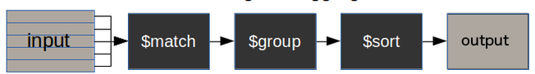
MongoDB Aggregation Framework
$match stage – filters those documents we need to work with, those that fit our needs
$group stage – does the aggregation job
$sort stage – sorts the resulting documents the way we require (ascending or descending)

Slide 106
MongoDB aggregate pipeline syntax
db.collectionName.aggregate(pipeline, options)
collectionName – is the name of a collection,
pipeline – is an array that contains the aggregation stages,
options – optional parameters for the aggregation

Slide 107
$match
The $match stage allows us to choose just those documents from a collection that we want to work with.
It does this by filtering out those that do not follow our requirements.
db.Faculty.aggregate([{$match : {CITY:"NOIDA"}}, {$group : { _id : "$Deptt",totalage : {$sum : "$Age"}}}])
{ "_id" : "DS", "totalage" : 70 }
{ "_id" : "CSBS", "totalage" : 128 }
db.Faculty.aggregate([{$match : {CITY:"DELHI"}}, {$group : { _id : "$Deptt",totalage : {$sum : "$Age"}}}])
{ "_id" : "DS", "totalage" : 35 }
{ "_id" : "CSBS", "totalage" : 30 }

Slide 108
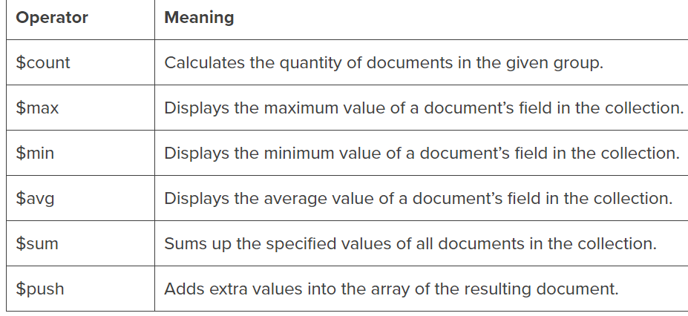
MongoDB $group aggregation operators

Slide 109
$group
db.Faculty.aggregate([{$group:{_id :"$CITY", count:{$sum:1}}}])
{ "_id" : "DELHI", "totalage" : 2 }
{ "_id" : "LUCKNOW", "totalage" : 1 }
{ "_id" : "NOIDA", "totalage" : 6 }
{ "_id" : "GREATER NOIDA", "totalage" : 1 }
db.Faculty.aggregate([{$group:{_id :"$CITY", minage:{$min:"$Age"}}}])
{ "_id" : "NOIDA", "maxage" : 32 }
{ "_id" : "GREATER NOIDA", "maxage" : 48 }
{ "_id" : "DELHI", "maxage" : 30 }
{ "_id" : "LUCKNOW", "maxage" : 45 }
db.Faculty.aggregate([{$group:{_id :"$CITY", maxage:{$max:"$Age"}}}])
{ "_id" : "DELHI", "maxage" : 35 }
{ "_id" : "LUCKNOW", "maxage" : 45 }
{ "_id" : "GREATER NOIDA", "maxage" : 48 }

Slide 110
$sort & $skip
Sorts all input documents and returns them to the pipeline in sorted order.
Syntax:{ $sort: { <field1>: <sort order>, <field2>: <sort order> ... } }
db.Faculty.aggregate([{$sort:{ Age : 1}}]) (Ascending Order)
db.Faculty.aggregate([{$sort:{ Age : -1}}]) (Descending Order)
db.Faculty.aggregate([{$skip: 5}])

Slide 111
$project
Passes along the documents with the requested fields to the next stage in the pipeline.
The specified fields can be existing fields from the input documents or newly computed fields.
Syntax: { $project: { <specification(s)> } }
db.Faculty.aggregate( [ { $project : { CITY : 1 , Deptt : 1, Age : 1 } } ] )

Slide 112
Querying in NoSQL
Querying in NoSQL:
Suppose we want to get specific results on the transport database
.
{
"Brand":"Benz"
"Max_Speed":250
"Color":"Green“
}

Slide 113
What is MongoDB Compass?
MongoDB Compass is a powerful GUI for querying, aggregating, and analyzing your MongoDB data in a visual environment.
Compass is free to use and source available, and can be run on macOS, Windows, and Linux.

Slide 114
Download and Install Compass
Download Compass
To download Compass, you can use your preferred web browser.
Open the downloads page.
Select the installer you prefer. The MongoDB Compass installer is available as a .exe or .msi package or a .zip archive.
Download the latest version of MongoDB Compass for Windows.
Install Compass
Double-click the installer file.
Follow the prompts to install Compass. You can select the destination of the Compass installation.
Once installed, Compass launches and prompts you to configure privacy settings and specify update preferences.

Slide 115
DAILY QUIZ
1.1: Check all the right affirmations.
SQLite is a Client/Server database engine.
SQLite can be used for free.
SQLite doesn’t requires additional installations.
SQLite doesn’t support multiple users.
1.2: Xojo always implements the latest available SQLite Library.
No.
Yes.

Slide 116
DAILY QUIZ
1.3: Xojo supports multiple SQLite databases use.
No.
Yes, they always have the same number of Tables in their structure.
Yes.
1.4: What Xojo Licenses offer support for SQLite?
Desktop Lite, Desktop, Console and iOS.
All of them, except Web.
All of them, you pay the required royalties for each deployment platform.
All of them.

Slide 117
Weekly Assignment
Check if Table Exists in SQLite using Python
How to list tables using SQLite3 in Python ?
How to Alter a SQLite Table using Python ?
How to Delete a Specific Row from SQLite Table using Python ?
How to Update all the Values of a Specific Column of SQLite Table using Python

Slide 118
TOPIC LINKS
Suggested video link
https://youtu.be/I4NRCN9DPTI
https://youtu.be/IESCYrdaiVY

Slide 119
MCQ
What does NoSQL stand for?
A. Non-Sequential Query Language
B. Not Only SQL
C. New Object-Oriented Structure Language
D. Non-Relational Structured Query Language
Which of the following is a key characteristic of NoSQL databases?
A. Strict schema definition
B. ACID compliance
C. Horizontal scalability
D. Exclusive use of SQL language
In NoSQL databases, what does the term "CAP theorem" refer to?
A. Consistency, Availability, Partition tolerance
B. Concurrent, Atomic, Parallelism
C. Cluster, Aggregation, Partitioning
D. Compatibility, Accuracy, Performance

Slide 120
MCQ
Which data model is commonly associated with NoSQL databases?
A. Relational
B. Hierarchical
C. Document-oriented
D. Entity-Relationship
Which type of NoSQL database is best suited for handling highly interconnected data and relationships?
A. Key-Value
B. Document-oriented
C. Graph
D. Column-family
What is the purpose of sharding in NoSQL databases?
A. Ensuring data consistency
B. Distributing data across multiple nodes
C. Defining schema for data
D. Enforcing referential integrity
Which NoSQL database is often used for real-time analytics and event tracking?
A. MongoDB
B. Cassandra
C. Redis
D. Apache Kafka

Slide 121
MCQ
Which of the following is an example of a wide-column store NoSQL database?
A. MongoDB
B. CouchDB
C. Cassandra
D. Redis
Answers:
B. Not Only SQL
C. Horizontal scalability
A. Consistency, Availability, Partition tolerance
C. Document-oriented
C. Graph
B. Distributing data across multiple nodes
D. Apache Kafka
B. Strong consistency
A. Improved query performance
C. Cassandra

Slide 122

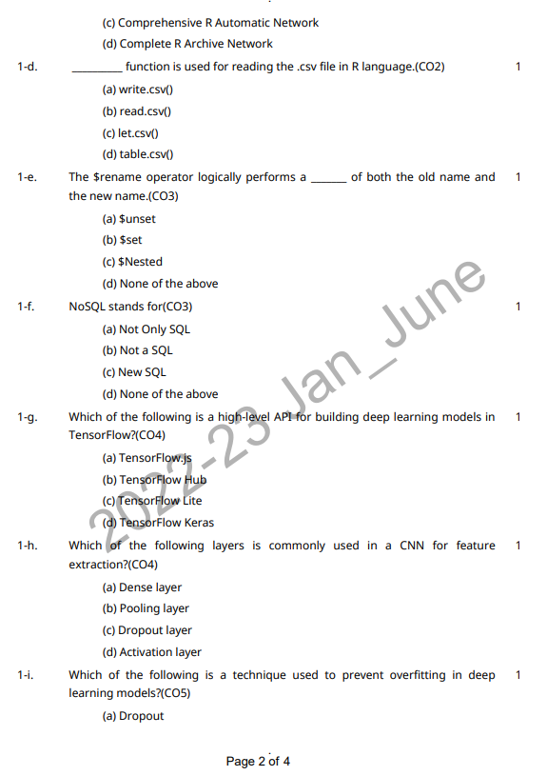
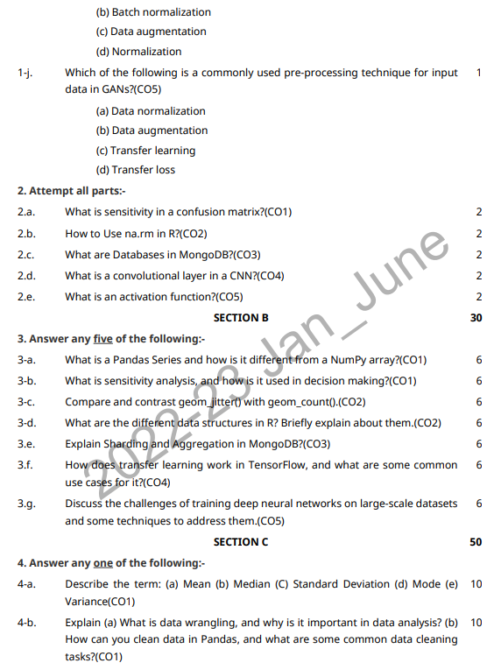
Old University Question Paper

Slide 123
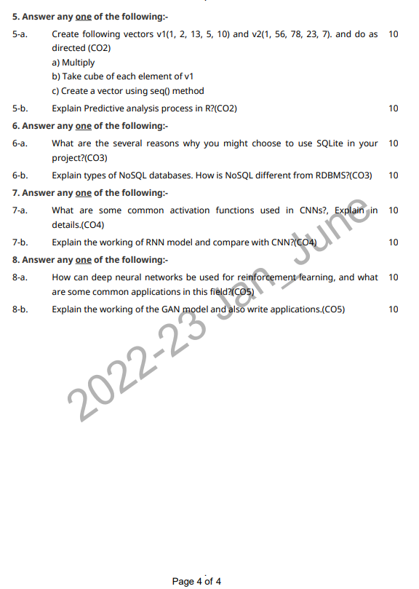
Old University Question Paper
Link to download Paper: https://www.niet.co.in/pdf/previous-years/2022-23/6th-Semester-2022-2023/ACSAI0617.pdf

Slide 124
Expected Questions
Explain Comparison Logical Operator with example.
Explain Comparison Query Operator with example.
Explain MongoDB Shell commands with syntax and example.
How does MongoDB ensure the availability of Data? Explain with example.
Compare the features of MongoDB with RDBMS
Explain the features of MongoDB.
Explain difference between group by and order by with example in respect of SQLite.
Explain cursor object? How does is help in SQLite database connection ?
Explain how can you delete or add columns from an existing table in SQLite?
What are NoSQL databases? What are the different types of NoSQL databases?
Does MongoDB support ACID Transaction? Define ACID Transaction?
What are the aggregate functions of MongoDB?

Slide 125
Recap of Unit
Reading and writing operations are very fast for SQLite database. It is faster than File system.
It only loads the data which is needed, rather than reading the entire file and hold it in memory.

Slide 126
References
Text Books:
(1) Glenn J. Myatt, Making sense of Data: A practical Guide to Exploratory Data Analysis and Data Mining, John Wiley Publishers, 2007.
(2) Learning TensorFlow by Tom Hope, Yehezkel S. Resheff, Itay Lieder O'Reilly Media, Inc.
(3) Advanced Deep Learning with TensorFlow 2 and Keras: Apply DL, GANs, VAEs, deep RL, unsupervised learning, object detection and segmentation, and more, 2nd Edition.
Reference Books:
(4) Boris lublinsky, Kevin t. Smith, Alexey Yakubovich, “Professional Hadoop Solutions”, 1 st Edition, Wrox, 2013.
(5) Chris Eaton, Dirk Deroos et. al., “Understanding Big data”, Indian Edition, McGraw Hill, 2015.
(6) Tom White, “HADOOP: The definitive Guide”, 3 rd Edition, O Reilly, 2012

Slide 127
Thank You

